Slide 1


AFL STATISTICAL ANALYSIS Project members: Karin Ferrada, Josh Thomas, Andy de Wind

Slide 2
PROJECT AIM
Our project is to uncover patterns in Australian Football League (AFL) data.
We'll examine relationships between draft picks and their influence on Premierships, playing career and individual awards; scoring trends over the last 2 decades; teams playing at a home venue and the influence on umpires

Slide 3
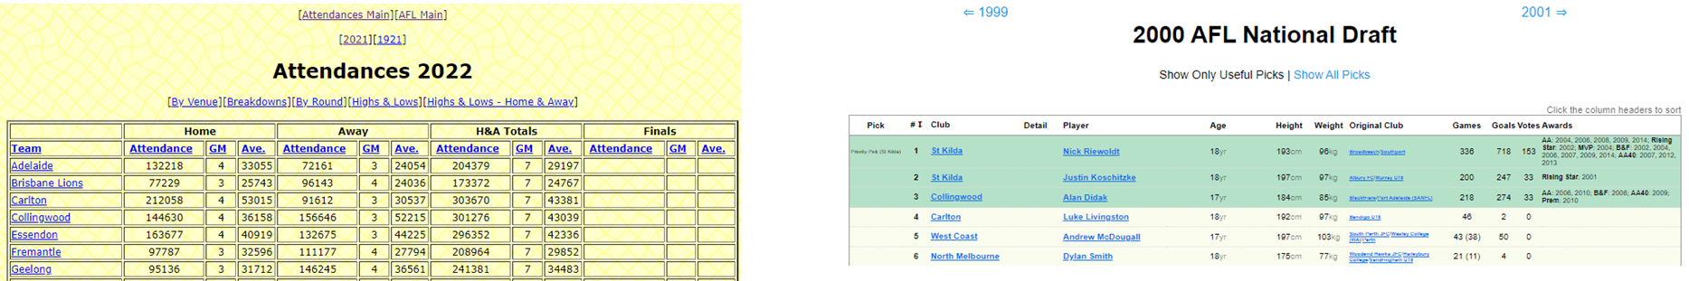
EXPLORATION
Our initial exploration of data began on the AFL website. It was very quickly identified that other websites track historical data extensively. For this project data has been sourced directly from:
www.afltables.com www.draftguru.com.au

Slide 4
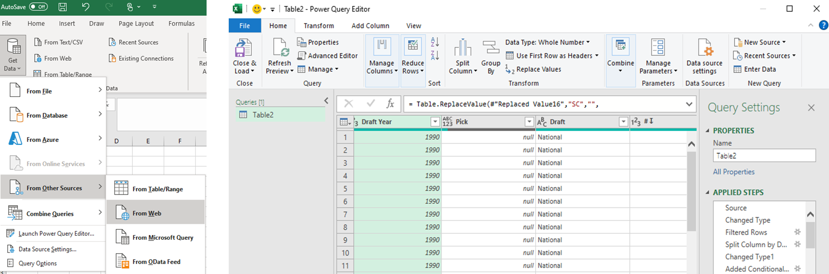
DATA CLEANUP
The data on these websites is freely accessible and with the use of Power Query within Excel we were able to import the data directly from the website.
Power Query allowed us also allowed us to clean the data into the appropriate format required and ensure it could be read into a Juypter file.

Slide 5

AFL NATIONAL DRAFT
Each year a national draft is held where AFL teams scout and recruit top prospects
The draft operates in a “reverse order” based on the ladder result of the previous season
This helps create a stable competition whereby struggling teams obtain the top draft picks
Only National considered, other draft types exist (Pre-season, Trades, Free Agency)
Draft data is from 1990 – 2018

Slide 6
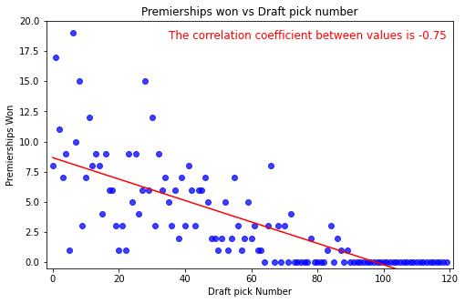
DO TOP PICKS RESULT IN PREMIERSHIPS?
This graph illustrates that top draft picks result in more premierships being won
Selecting the right player is critical to AFL teams for premiership success

Slide 7
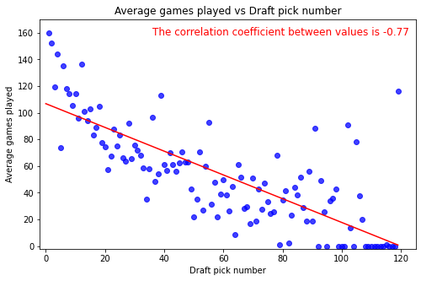
DRAFT PICKS AND PLAYING CAREER?
This graph shows that the top draft picks also result in more games being played
Selecting the right player results in a longer playing career

Slide 8
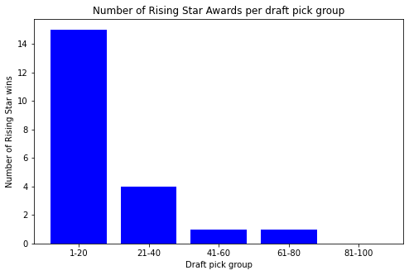
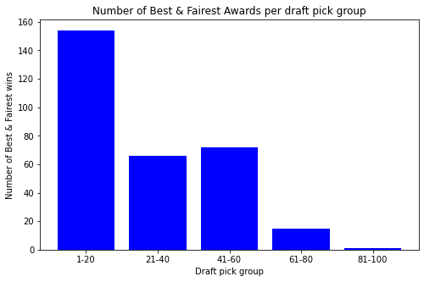
DRAFT PICKS AND AWARDS?
These graphs illustrate that the top draft picks result in a higher number of individual awards
Player worth
Guernsey sales
Increase in attendance
Increase in memberships

Slide 9
HAS AFL SCORING BEEN ON A DOWNWARD OR UPWARD TREND IN THE LAST TWO DECADES?
Using available Data from AFL Tables.com I have used Yearly Data from 2000 to 2021 with the exclusion of 2020 to see the Average Final Scores of AFL Matches
2020 Has been excluded from the research as the year was affected by COVID -19 and in result had less games and shortened quarter lengths

Slide 10
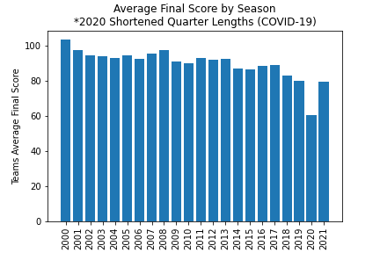
This Graph shows us that since the Year 2000 Scoring in the AFL has been on a steady Decline
Why would this matter for the AFL? The AFL wants a higher scoring game for greater fan engagement and to produce a better product for entertainment purposes and TV.

Slide 11
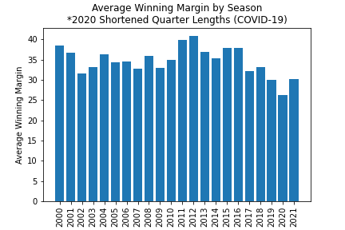
After seeing that Total Game score has been on a steady decrease has this affect the final winning margins?
We might expect a similar decrease in average winning margins with the total score decreasing yearly. However as shown by this graph the pattern is not as consistent as the decrease in scores

Slide 12
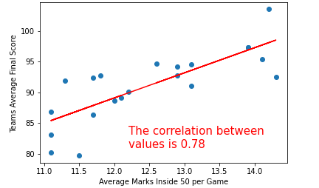
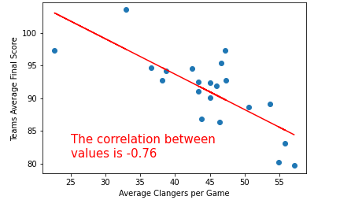
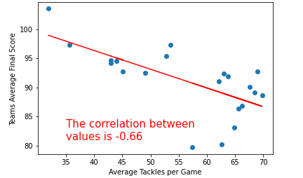
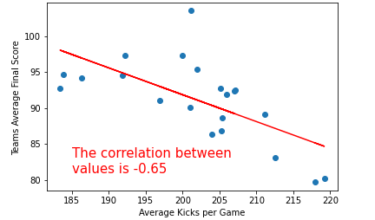
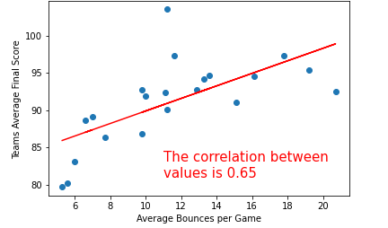
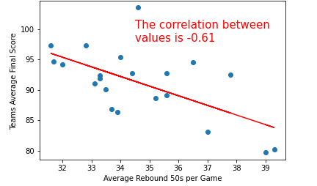
Correlation >0.6 or -0.6 between Average Scoring and Average Stat Categories per AFL Game
Marks Inside 50
Clangers
Tackles
Kicks
Running Bounces
Rebound 50s

Slide 13
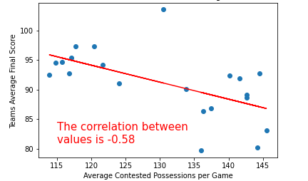
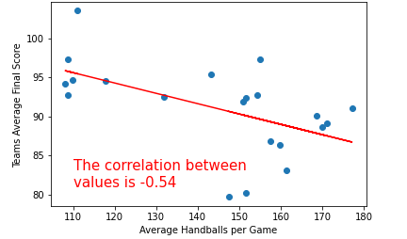
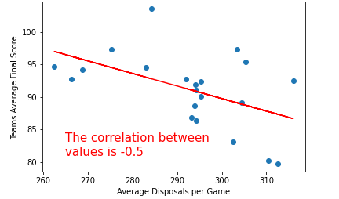
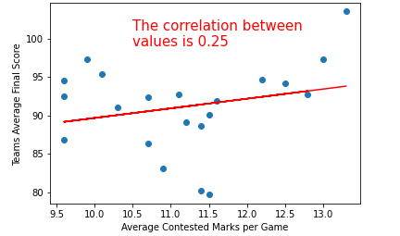
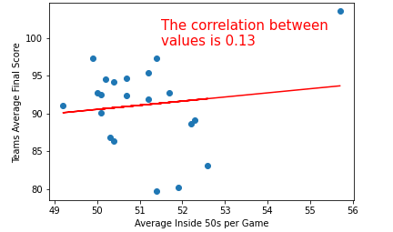
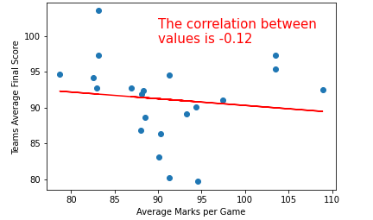
Correlation <0.6 or -0.6 between Average Scoring and Average Stat Categories per AFL Game
Contested Possessions
Handballs
Disposals
Contested Marks
Entries Inside 50
Overall Marks

Slide 14
WHAT DOES THIS DATA SAY ABOUT WHY THE SCORING HAS BEEN ON A DECLINE?
Marks Inside 50
Marks inside 50 have heavily decreased since 2000
This stat is a key statistic to why scores has have been trending down
This is because it is a guaranteed scoring shot at goal

Slide 15
WHAT DOES THIS DATA SAY ABOUT WHY THE SCORING HAS BEEN ON A DECLINE
Tackles and Clangers have increased but are highly correlated to lower scoring
Running Bounces have heavily decreased and less bounces are correlated to lower scoring
Kicks, Contested Possessions and Rebound 50s are up which is correlated to lower scoring
Inside 50 Entries and Marks seem to have no correlation to lower scoring

Slide 16
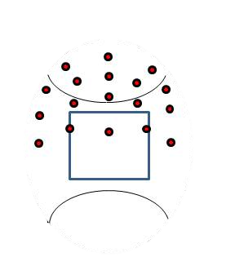
CONCLUSION
The tactics of the game have changed over the last two decades with an emphasis on guarding and closing down space around the ground and defensive 50. As seen by less Marks Inside 50 and less running bounces
More Pressure around Contests in the back half has seen tackles increase and in turn Clangers have increased.
All these factors have resulted in lower overall scoring trends

Slide 17
DOES PLAYING AT A HOME VENUE INFLUENCE UMPIRES?
Do home team players receive more Brownlow votes?
Do home teams get more free kicks than their visiting opponents?
How do teams perform in front of their home fans. Better or worse?

Slide 18
BROWNLOW VOTES
Umpires vote on the Best on Ground (BOG) for each home and away game according to the following:
The central field umpires gather together after the game to vote accordingly:
Best player gets 3 votes,
Second best gets 2 votes and
Third best gets 1 vote
This is done only during home and away matches culminating on the Monday before the Grand Final on Brownlow night when the votes are tabulated, and the winner is announced as Fairest and Best play for the whole home and away season.
Votes for players who miss 1 or more games due to foul play are considered ineligible

Slide 19
BROWNLOW VOTES
Analysis was completed across 3 seasons 2017, 2018 and 2019.
As mentioned previously seasons 2020 and 2021 were not included as they were seasons that were affected by CoViD hubs.

Slide 20
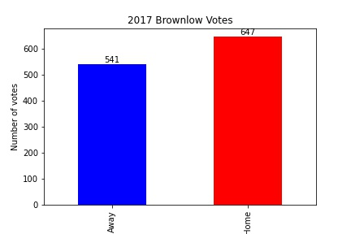
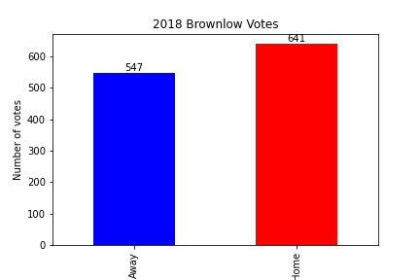
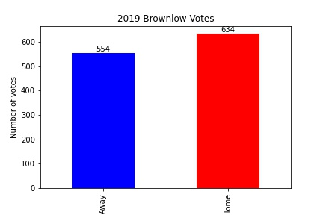
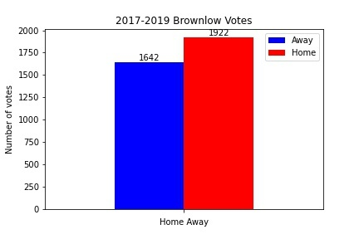
BROWNLOW VOTES

Slide 21

CONCLUSION - BROWNLOW
Players on home teams do get more votes than players on visiting teams.
This could be related to teams playing at home do better in front of their home supporters and hence get the umpires’ votes.

Slide 22
WIN LOSS RECORD FOR HOME AND AWAY FIXTURES
This analysis is for all home and away seasons going back over 30 years and attempts to answer the question: How do teams perform in front of their home fans. Better or worse?
Some of the clubs no longer exist like Fitzroy whilst others are fairly new and hence have played less games. Teams like Greater Western Sydney (GWS) and Gold Coast (GC).

Slide 23
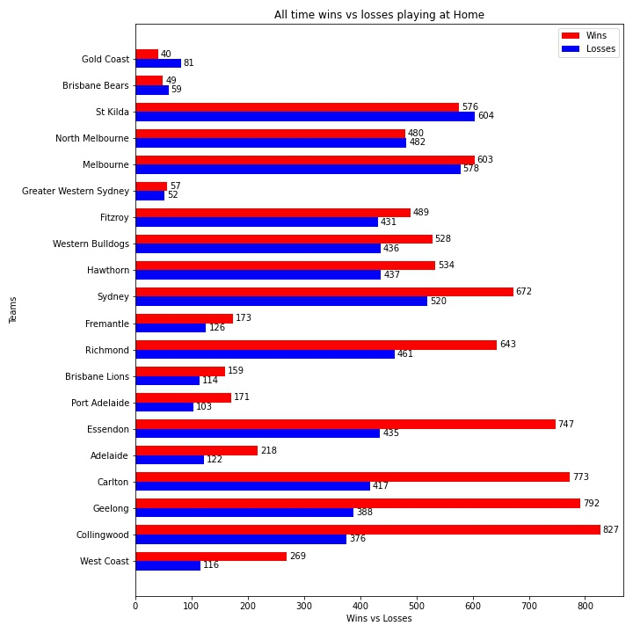
WINS VS LOSSES BY TEAMS WHEN PLAYING HOME
Clear trend that teams playing at HOME win more of their games than when they play away in front of less of their fans.
There are some exceptions for example Brisbane Bears, they were a new team established in NRL territory, so they had few fans attending their home games but when they became the Brisbane Lions after merging with the established Melbourne club Fitzroy they gained a lot more fans and their win/loss record went the other way.
Established Melbourne based clubs like Collingwood and Carlton went against trend as a lot of their away games were played at their home ground like the MCG which they share with other Melbourne clubs.
A good attendance by supporters at games does seem to impact the outcome.

Slide 24
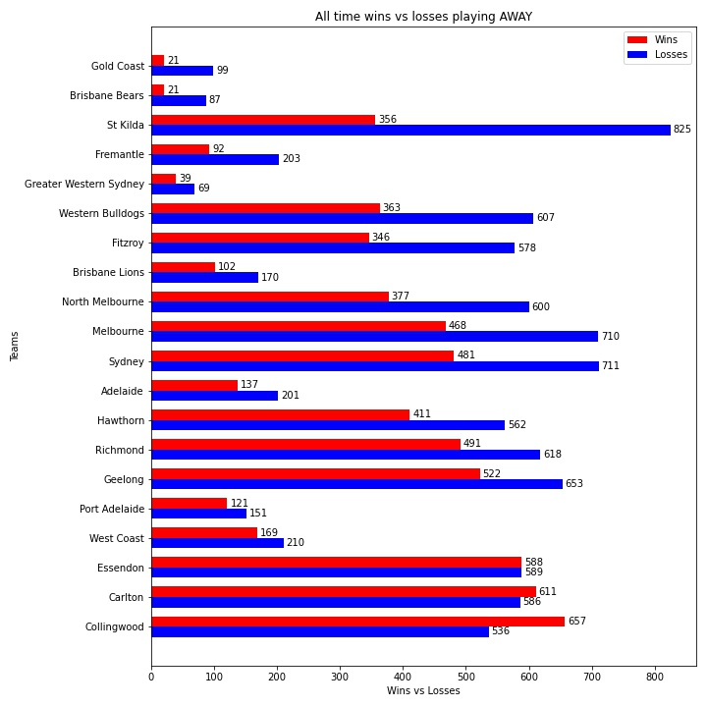
WINS VS LOSSES BY TEAMS WHEN PLAYING AWAY
Clear trend that teams playing AWAY lose more games than when they play at HOME in front of more of their fans.
As mentioned previously there are some exceptions for example Brisbane Bears, they were a new team established in NRL territory, so they had few fans attending their home games but when they became the Brisbane Lions after merging with the established Melbourne club Fitzroy they gained a lot more fans and their win/loss record went the other way.
Established Melbourne based clubs like Collingwood and Carlton go against the trend as a large amount of their away games are played at their home ground like the MCG which they share with other Melbourne clubs.
A good attendance by supporters at games does seem to impact the outcome.

Slide 25
FREE KICKS AWARDED DURING THE HOME AND AWAY FIXTURES
This analysis is for all home and away seasons going back over 30 years and attempts to answer the question: Do home teams get more free kicks than their visiting opponents?

Slide 26
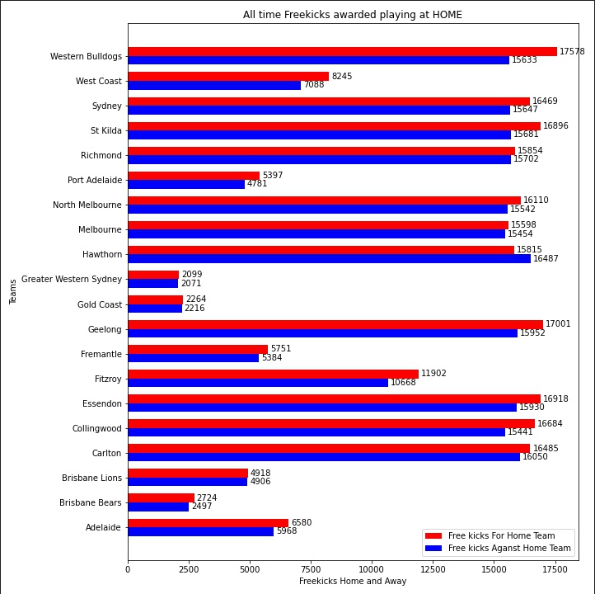
FREE KICK BY TEAMS WHEN PLAYING HOME
The conclusion that may be drawn from this graph is that teams playing at home do tend to get more freekicks in their favour whereas playing away gets them less.
There are some exceptions but that appears to be with Melbourne based clubs who do play a lot of their away games at their home ground but with less of their fans able to attend.
So fan support appears to have some bearing on the outcome.

Slide 27
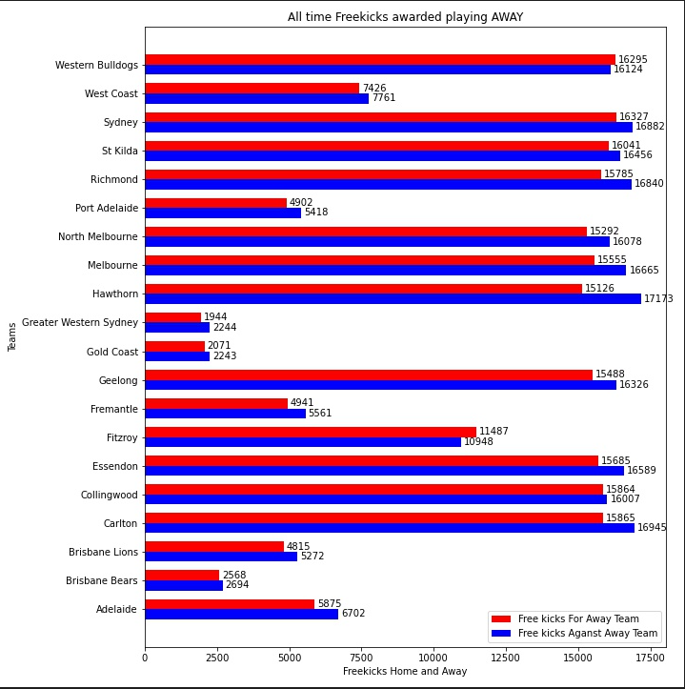
FREE KICK BY TEAMS WHEN PLAYING AWAY
The conclusion that may be drawn from this graph is that teams playing away do not tend to get more freekicks in their favour whereas home teams do.
There are some exceptions but that appears to be with Melbourne based clubs who do play a lot of their away games at their home ground but with less of their fans able to attend.
So fan support appears to have some bearing on the outcome.

